Slide 1
Functions and Surfaces
9.6

Slide 2
Functions of Two Variables

Slide 3
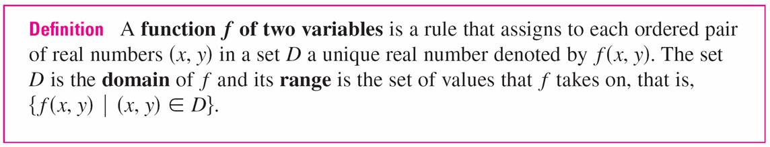
Functions of Two Variables
The temperature T at a point on the surface of the earth at any given time depends on the longitude x and latitude y of the point.
We can think of T as being a function of the two variables
x and y, or as a function of the pair (x, y). We indicate this functional dependence by writing T = f (x, y).
The volume V of a circular cylinder depends on its radius r and its height h. In fact, we know that V = πr²h. We say that
V is a function of r and h, and we write V(r, h) = πr²h.

Slide 4

Functions of Two Variables
We often write z = f (x, y) to make explicit the value taken on by f at the general point (x, y). The variables x and y are independent variables and z is the dependent variable. [Compare this with the notation y = f (x) for functions of a single variable.]
The domain is a subset of , the xy-plane. We can think of the domain as the set of all possible inputs and the range as the set of all possible outputs.
If a function f is given by a formula and no domain is specified, then the domain of f is understood to be the set of all pairs (x, y) for which the given expression is a
well-defined real number.

Slide 5

Example 1 – Domain and Range
If f (x, y) = 4x² + y², then f (x, y) is defined for all possible ordered pairs of real numbers (x, y), so the domain is , the entire xy-plane.
The range of f is the set [0, ) of all nonnegative real numbers. [Notice that x² ≥ 0 and y² ≥ 0, so f (x, y) ≥ 0 for all x and y.]

Slide 6
Graphs

Slide 7
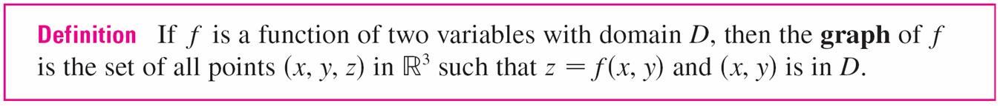
Graphs
One way of visualizing the behavior of a function of two variables is to consider its graph.
Just as the graph of a function f of one variable is a curve C with equation y = f (x), so the graph of a function f of two variables is a surface S with equation z = f (x, y).

Slide 8
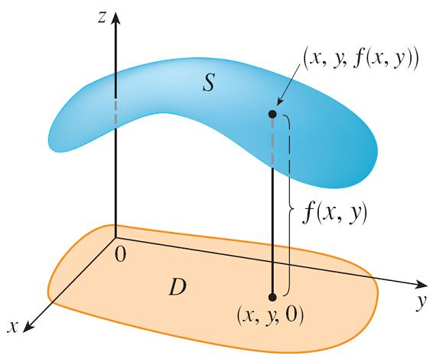
Graphs
We can visualize the graph S of f as lying directly above or below its domain D in the xy–plane (see Figure 3).
Figure 3

Slide 9
Example 4 – Graphing a Linear Function
Sketch the graph of the function f (x, y) = 6 – 3x – 2y.
Solution:
The graph of f has the equation z = 6 – 3x – 2y,
or 3x + 2y + z = 6, which represents a plane.
To graph the plane we first find the intercepts.
Putting y = z = 0 in the equation, we get x = 2 as the
x-intercept.
Similarly, the y-intercept is 3 and the z-intercept is 6.

Slide 10
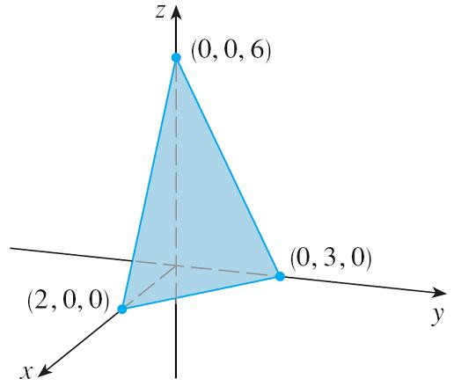
Example 4 – Solution
cont’d
This helps us sketch the portion of the graph that lies in the first octant in Figure 4.
Figure 4

Slide 11
Graphs
The function in Example 4 is a special case of the function
f (x, y) = ax + by + c
which is called a linear function.
The graph of such a function has the equation
z = ax + by + c or ax + by – z + c = 0
so it is a plane.

Slide 12
Example 5
Sketch the graph of the function f (x, y) = x².
Solution:
Notice that, no matter what value we give y, the value of
f (x, y) is always x².
The equation of the graph is z = x², which doesn’t involve y.
This means that any vertical plane with equation y = k (parallel to the xz-plane) intersects the graph in a curve with equation z = x², that is, a parabola.

Slide 13
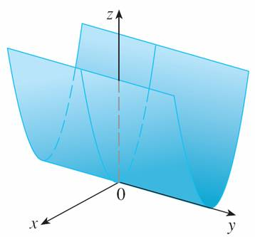
Example 5 – Solution
cont’d
Figure 5 shows how the graph is formed by taking the parabola z = x² in the xz-plane and moving it in the direction of the y-axis.
So the graph is a surface, called a parabolic cylinder, made up of infinitely many shifted copies of the same parabola.
Figure 5
The graph of f(x, y) = x² is the parabolic cylinder z = x².

Slide 14
Graphs
In sketching the graphs of functions of two variables, it’s often useful to start by determining the shapes of
cross-sections (slices) of the graph.
For example, if we keep x fixed by putting x = k (a constant) and letting y vary, the result is a function of one variable
z = f (k, y), whose graph is the curve that results when we intersect the surface z = f (x, y) with the vertical plane x = k.

Slide 15
Graphs
In a similar fashion we can slice the surface with the vertical plane y = k and look at the curves z = f (x, k).
We can also slice with horizontal planes z = k. All three types of curves are called traces (or cross-sections) of the surface z = f (x, y).

Slide 16
Example 6
Use traces to sketch the graph of the function
f (x, y) = 4x² + y².
Solution:
The equation of the graph is z = 4x² + y². If we put x = 0, we get z = y², so the yz-plane intersects the surface in a parabola.
If we put x = k (a constant), we get z = y² + 4k². This means that if we slice the graph with any plane parallel to the
yz-plane, we obtain a parabola that opens upward.

Slide 17
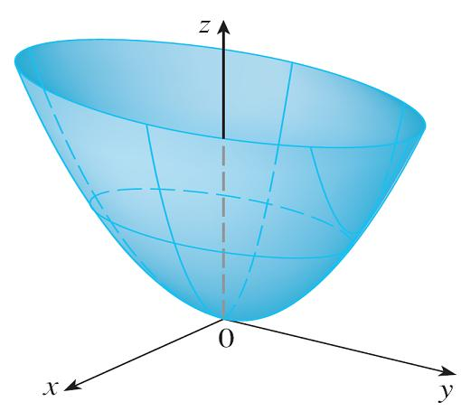
Example 6 – Solution
cont’d
Similarly, if y = k, the trace is z = 4x² + k², which is again a
parabola that opens upward. If we put z = k, we get the
horizontal traces 4x² + y² = k, which we recognize as a
family of ellipses.
Knowing the shapes of the
traces, we can sketch the
graph of f in Figure 6.
Because of the elliptical and
parabolic traces, the surface
z = 4x² + y² is called an
elliptic paraboloid.
Figure 6
The graph of f (x, y) = 4x² + y² is
the elliptic paraboloid z = 4x² + y².
Horizontal traces are ellipses;
vertical traces are parabolas.

Slide 18
Example 7
Sketch the graph of f (x, y) = y² – x².
Solution:
The traces in the vertical planes x = k are the parabolas
z = y² – x², which open upward.
The traces in y = k are the parabolas z = –x² + k², which open downward.
The horizontal traces are y² – x² = k, a family of hyperbolas.

Slide 19
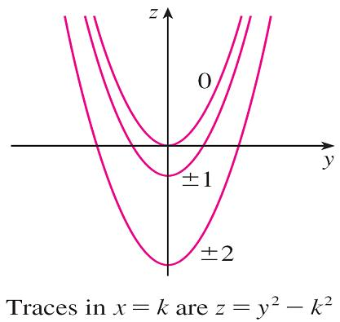
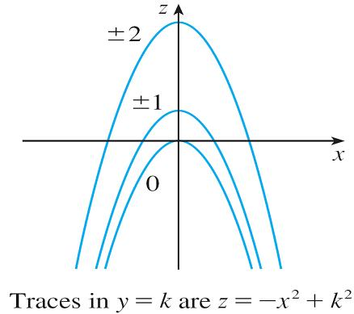
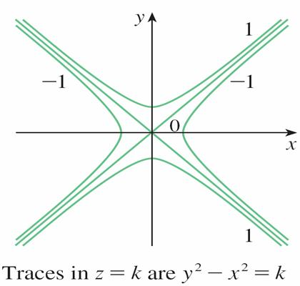
Example 7 – Solution
cont’d
We draw the families of traces in Figure 7.
Figure 7
Vertical traces are parabolas; horizontal traces are hyperbolas. All traces are labeled with the value of k.

Slide 20
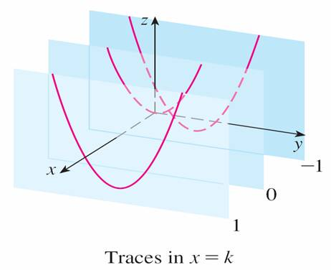
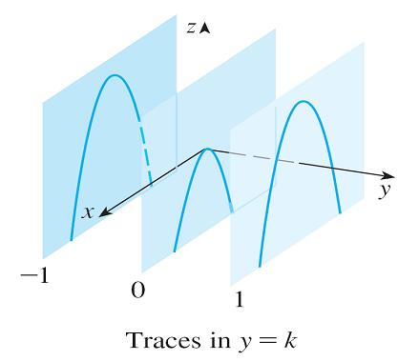
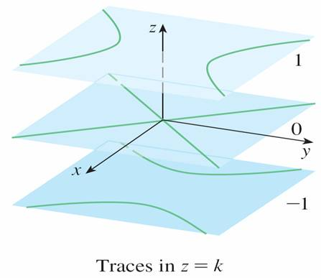
Example 7 – Solution
cont’d
We show how the traces appear when placed in their correct planes in Figure 8.
Traces moved to their correct planes
Figure 8

Slide 21
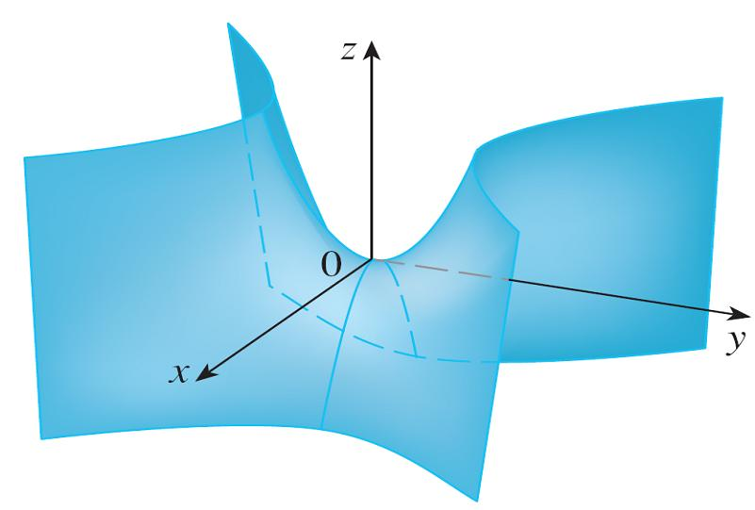
Graphs
In Figure 9 we fit together the traces from Figure 8 to form the surface z = y² – x², a hyperbolic paraboloid. Notice that the shape of the surface near the origin resembles that of a saddle.
Figure 9
The graph of f (x, y) = y² – x² is the hyperbolic paraboloid z = y² – x².

Slide 22
Graphs
The idea of using traces to draw a surface is employed in three-dimensional graphing software for computers.
In most such software, traces in the vertical planes x = k and y = k are drawn for equally spaced values of k and parts of the graph are eliminated using hidden line removal.

Slide 23
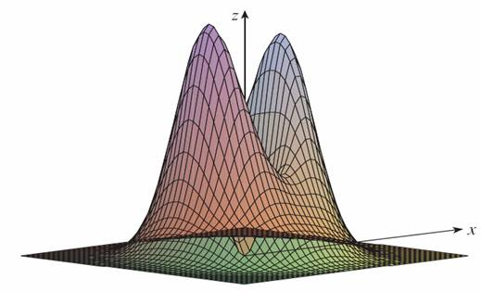
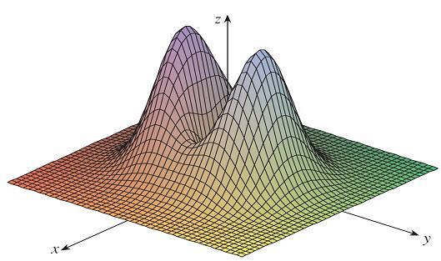

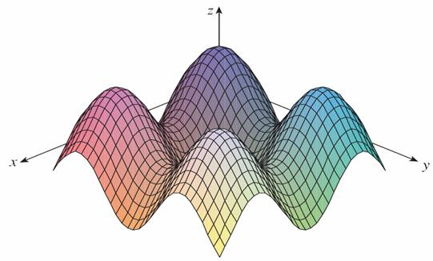
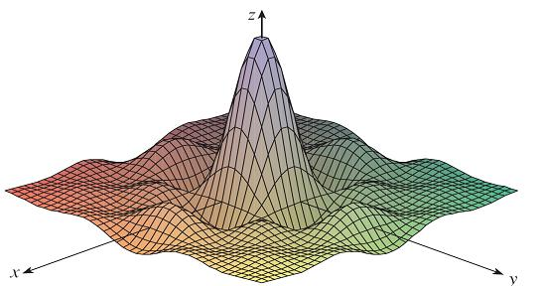


Graphs
Figure 10 shows computer-generated graphs of several functions.
Figure 10

Slide 24
Graphs
Notice that we get an especially good picture of a function when rotation is used to give views from different vantage points.
In parts (a) and (b) the graph of f is very flat and close
to the xy-plane except near the origin; this is because
e^{–x2 – y2} is very small when x or y is large.

Slide 25
Quadric Surfaces

Slide 26


Quadric Surfaces
The graph of a second-degree equation in three variables
x, y, and z is called a quadric surface.
We have already sketched the quadric surfaces
z = 4x² + y² (an elliptic paraboloid) and z = y² – x²
(a hyperbolic paraboloid) in Figures 6 and 9. In the next example we investigate a quadric surface called an ellipsoid.
The graph of f (x, y) = 4x² + y² is the elliptic paraboloid z = 4x² + y². Horizontal traces are ellipses; vertical traces are parabolas.
The graph of f (x, y)= y² – x² is the
hyperbolic paraboloid z = y² – x².
Figure 6
Figure 9

Slide 27
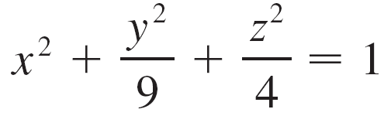
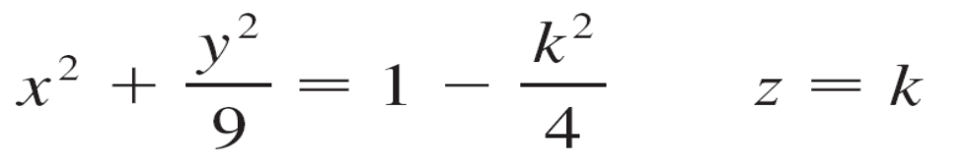
Example 8
Sketch the quadric surface with equation
Solution:
The trace in the xy-plane (z = 0) is x² + y²/9 = 1, which we recognize as an equation of an ellipse. In general, the horizontal trace in the plane z = k is
which is an ellipse, provided that k² < 4, that is, –2 < k < 2.

Slide 28
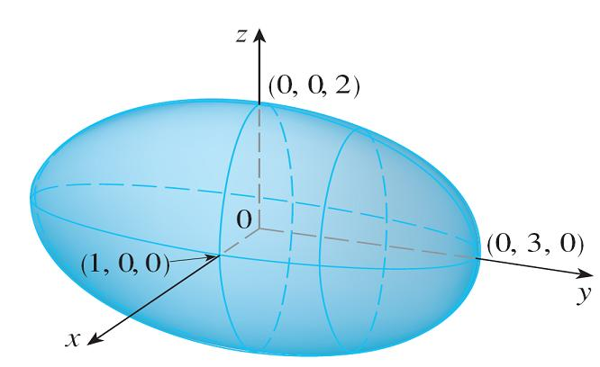

Example 8 – Solution
cont’d
Similarly, the vertical traces are also ellipses:
Figure 11 shows how drawing
some traces indicates the
shape of the surface.
Figure 11

Slide 29
Example 8 – Solution
cont’d
It’s called an ellipsoid because all of its traces are ellipses.
Notice that it is symmetric with respect to each coordinate plane; this symmetry is a reflection of the fact that its equation involves only even powers of x, y, and z.

Slide 30
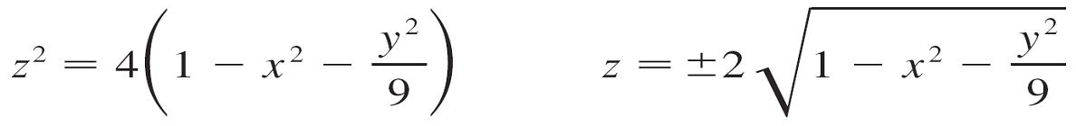
Quadric Surfaces
The ellipsoid in Example 8 is not the graph of a function because some vertical lines (such as the z-axis) intersect it more than once. But the top and bottom halves are graphs
of functions. In fact, if we solve the equation of the ellipsoid
for z, we get

Slide 31
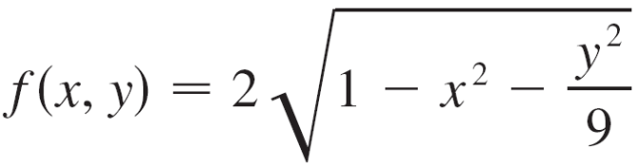
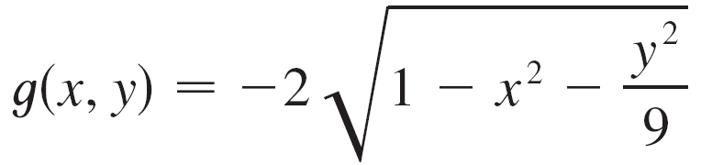
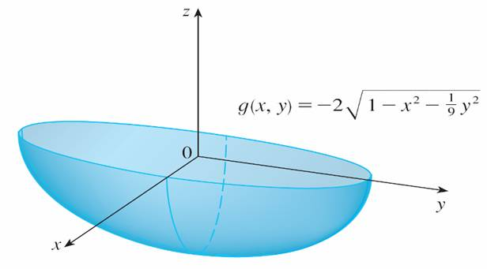
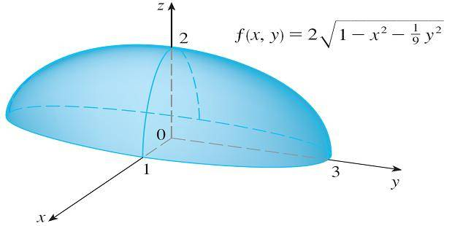
Quadric Surfaces
So the graphs of the functions
and
are the top and bottom halves of the ellipsoid
(see Figure 12).
Figure 12

Slide 32
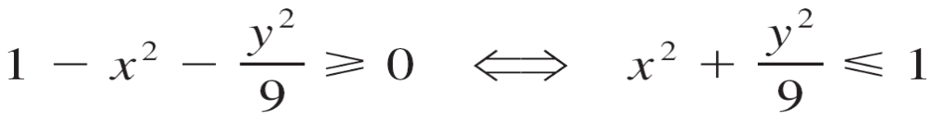
Quadric Surfaces
The domain of both f and g is the set of all points (x, y) such that
so the domain is the set of all points that lie on or inside the ellipse x² + y²/9 = 1.

Slide 33
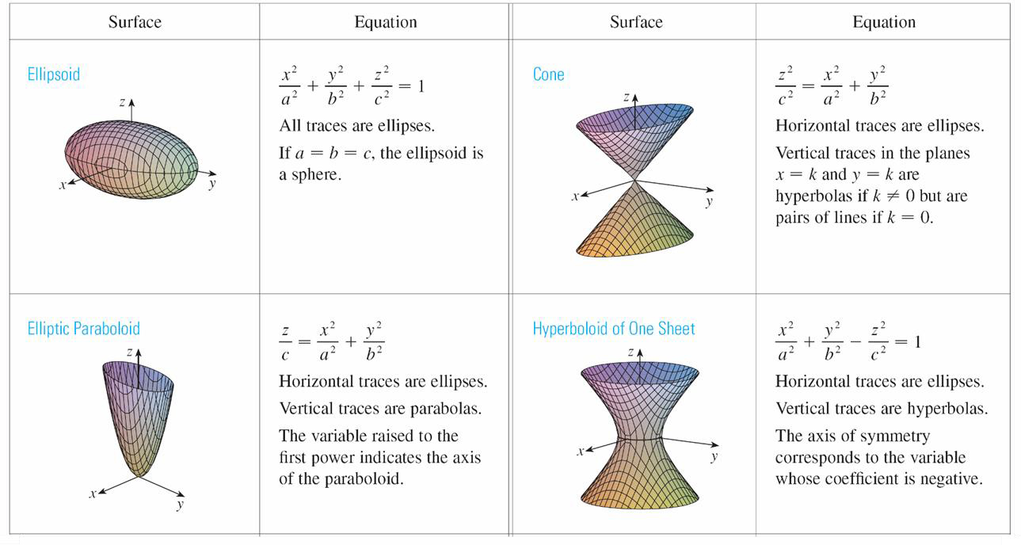
Quadric Surfaces
Table 2 shows computer-drawn graphs of the six basic types of quadric surfaces in standard form.
Table 2
Graphs of quadric surfaces

Slide 34
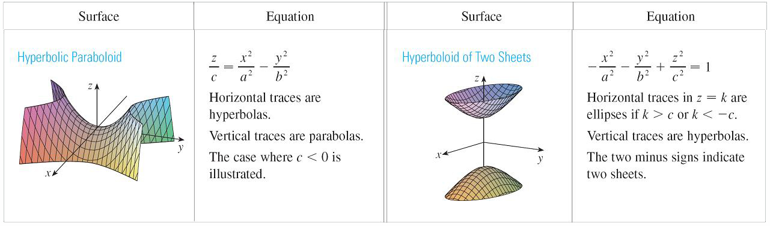
Quadric Surfaces
cont’d
All surfaces are symmetric with respect to the z-axis. If a quadric surface is symmetric about a different axis, its equation changes accordingly.
Table 2
Graphs of quadric surfaces

